Slide 1
Open Data and Knowledge Graphs
Carlos de la Cruz Ayala Vargas
Elías Herrero Lázaro
Rafael Orihuela Brindis
Pedro Pedregal Pérez

Slide 2
Objetive
We aim to show the measurements of air quality within a spatial context, using a Madrid City map and taking advantage of the information.
A user should be able to:
Select to see data from all stations or from only one.
Select whether data should belong to a specific day (showing that day's value) or to a time window (showing the average value for that period).
Select to see data pertaining to a specific parameter; only one parameter at a time.

Slide 3
Data set
The Data Set was obtained from the Madrid’s City Hall web page.
The data can be reused under certain guidelines that include citing the source, not distorting the information, and prohibiting the re-identification of personal data
The information shown is about the city’s air quality, measured every day in different stations located in Madrid.
The observations were recorded from January 1st 2023 to August 20th 2024 and are displayed as in the following table:
Provincia | Municipio | Estacion | Magnitud | Punto_muestreo | Año | Mes | D01 | V01 | D02 | V02
28 | 79 | 4 | 1 | 28079004_1_38 | 2023 | 1 | 18 | V | 20 | V

Slide 4
Data set
Additionally, we have another data set that explains the stations information.
The Data Set was obtained from the Madrid’s City Hall web page.
The data can be reused under certain guidelines that include citing the source, not distorting the information, and prohibiting the re-identification of personal data
The information of each station is displayed as in the following table:
Codigo | Corto | Estacion | Longitud | Latitud | Altitud | NO2 | SO2 | PM10 | Via_Clase | Via_PAR | Via_Nombre
28079004 | 4 | Plaza de España | 3°42'43.91"O | 40°25'25.98"N | 637 | X | X |  | PLAZA | DE | ESPAÑA

Slide 5
Ontology
Our ontology “mAIRres” was created based on ontologies already developed by the World Wide Web Consortium (W3C) and the Wikipedia Foundation, as:
SOSA (Sensor, Observation, Sample, and Actuator)
SSN (Semantic Sensor Network)
RDF (Resource Description Framework)
Wikidata (wd)
Designed to incorporate standards concepts widely used in environmental monitoring, we opted for using it since Assignment 2, as the lecturers emphasized, early on, its utmost importance to enhance interoperability and acceptance

Slide 6

Data processing
We used OpenRefine to adecuate our original data set to be able to analize it
The measures dataset had one row with 30 values. Changed to 1 row per value (valid columns were treated)
Representative magnitudes
Date joined in one column (yyyy-mm-dd)
Punto_muestreo | Año | Mes | D01 | V01 | D02 | V02 | D03 | V03
28079004_1_38 | 2023 | 1 | 18 | V | 20 | V | 14 | F
Magnitud | Punto_muestreo | ID_TIEMPO | MEDIDA
SO2 | 28079004_1_38 | 2023-01-01 | 20

Slide 7
Data processing
The stations dataset had many redundant columns
Deleted “Via” and “Corto” columns
Coordinates to decimal number
Measure type to true or false
Codigo | Corto | Estacion | Longitud | Latitud | Altitud | NO2 | SO2 | PM10 | Via_Clase | Via_PAR | Via_Nombre
28079004 | 4 | Plaza de España | 3°42'43.91"O | 40°25'25.98"N | 637 | X | X |  | PLAZA | DE | ESPAÑA
Codigo | Estacion | Longitud | Latitud | Altitud | NO2 | SO2 | PM10
28079004 | Plaza de España | -3.71 | 40.42 | 637 | true | true | false

Slide 8


RDF Generation
We build our mappings in YARRRML
So many problems with Matey. Changed to Morph
The ontology generation process has been automated with a Python script (cleaning, mapping and serializing)

Slide 9

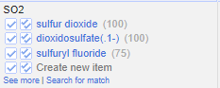
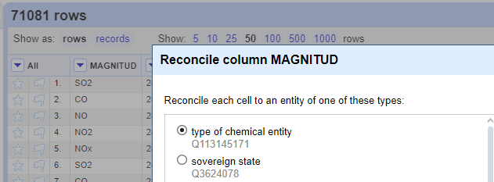
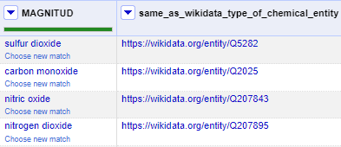
Data Linking
Reconciliation against WikiData was made using OpenRefine tool
Two categories selected:
Type of chemical entity
Streets (only a few of them were available)

Slide 10
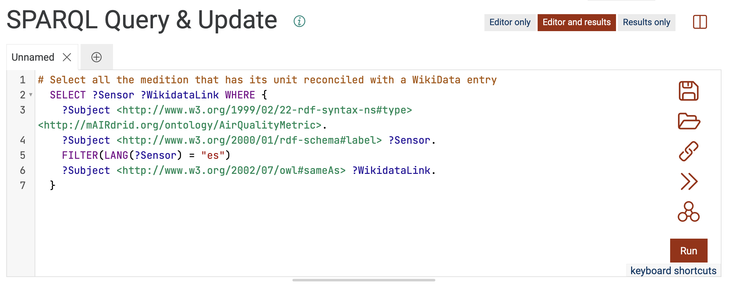
Linked Data Publishing
We used GraphDB to create a virtual server, where we published our final ontology.
This allowed us to accomplish three main goals:
Upload and store our final ontology.
Consult, using a SPARQL query, the information uploaded.
Published the final ontology and create an endpoint SPARQL for anyone who wants to access to the server.

Slide 11
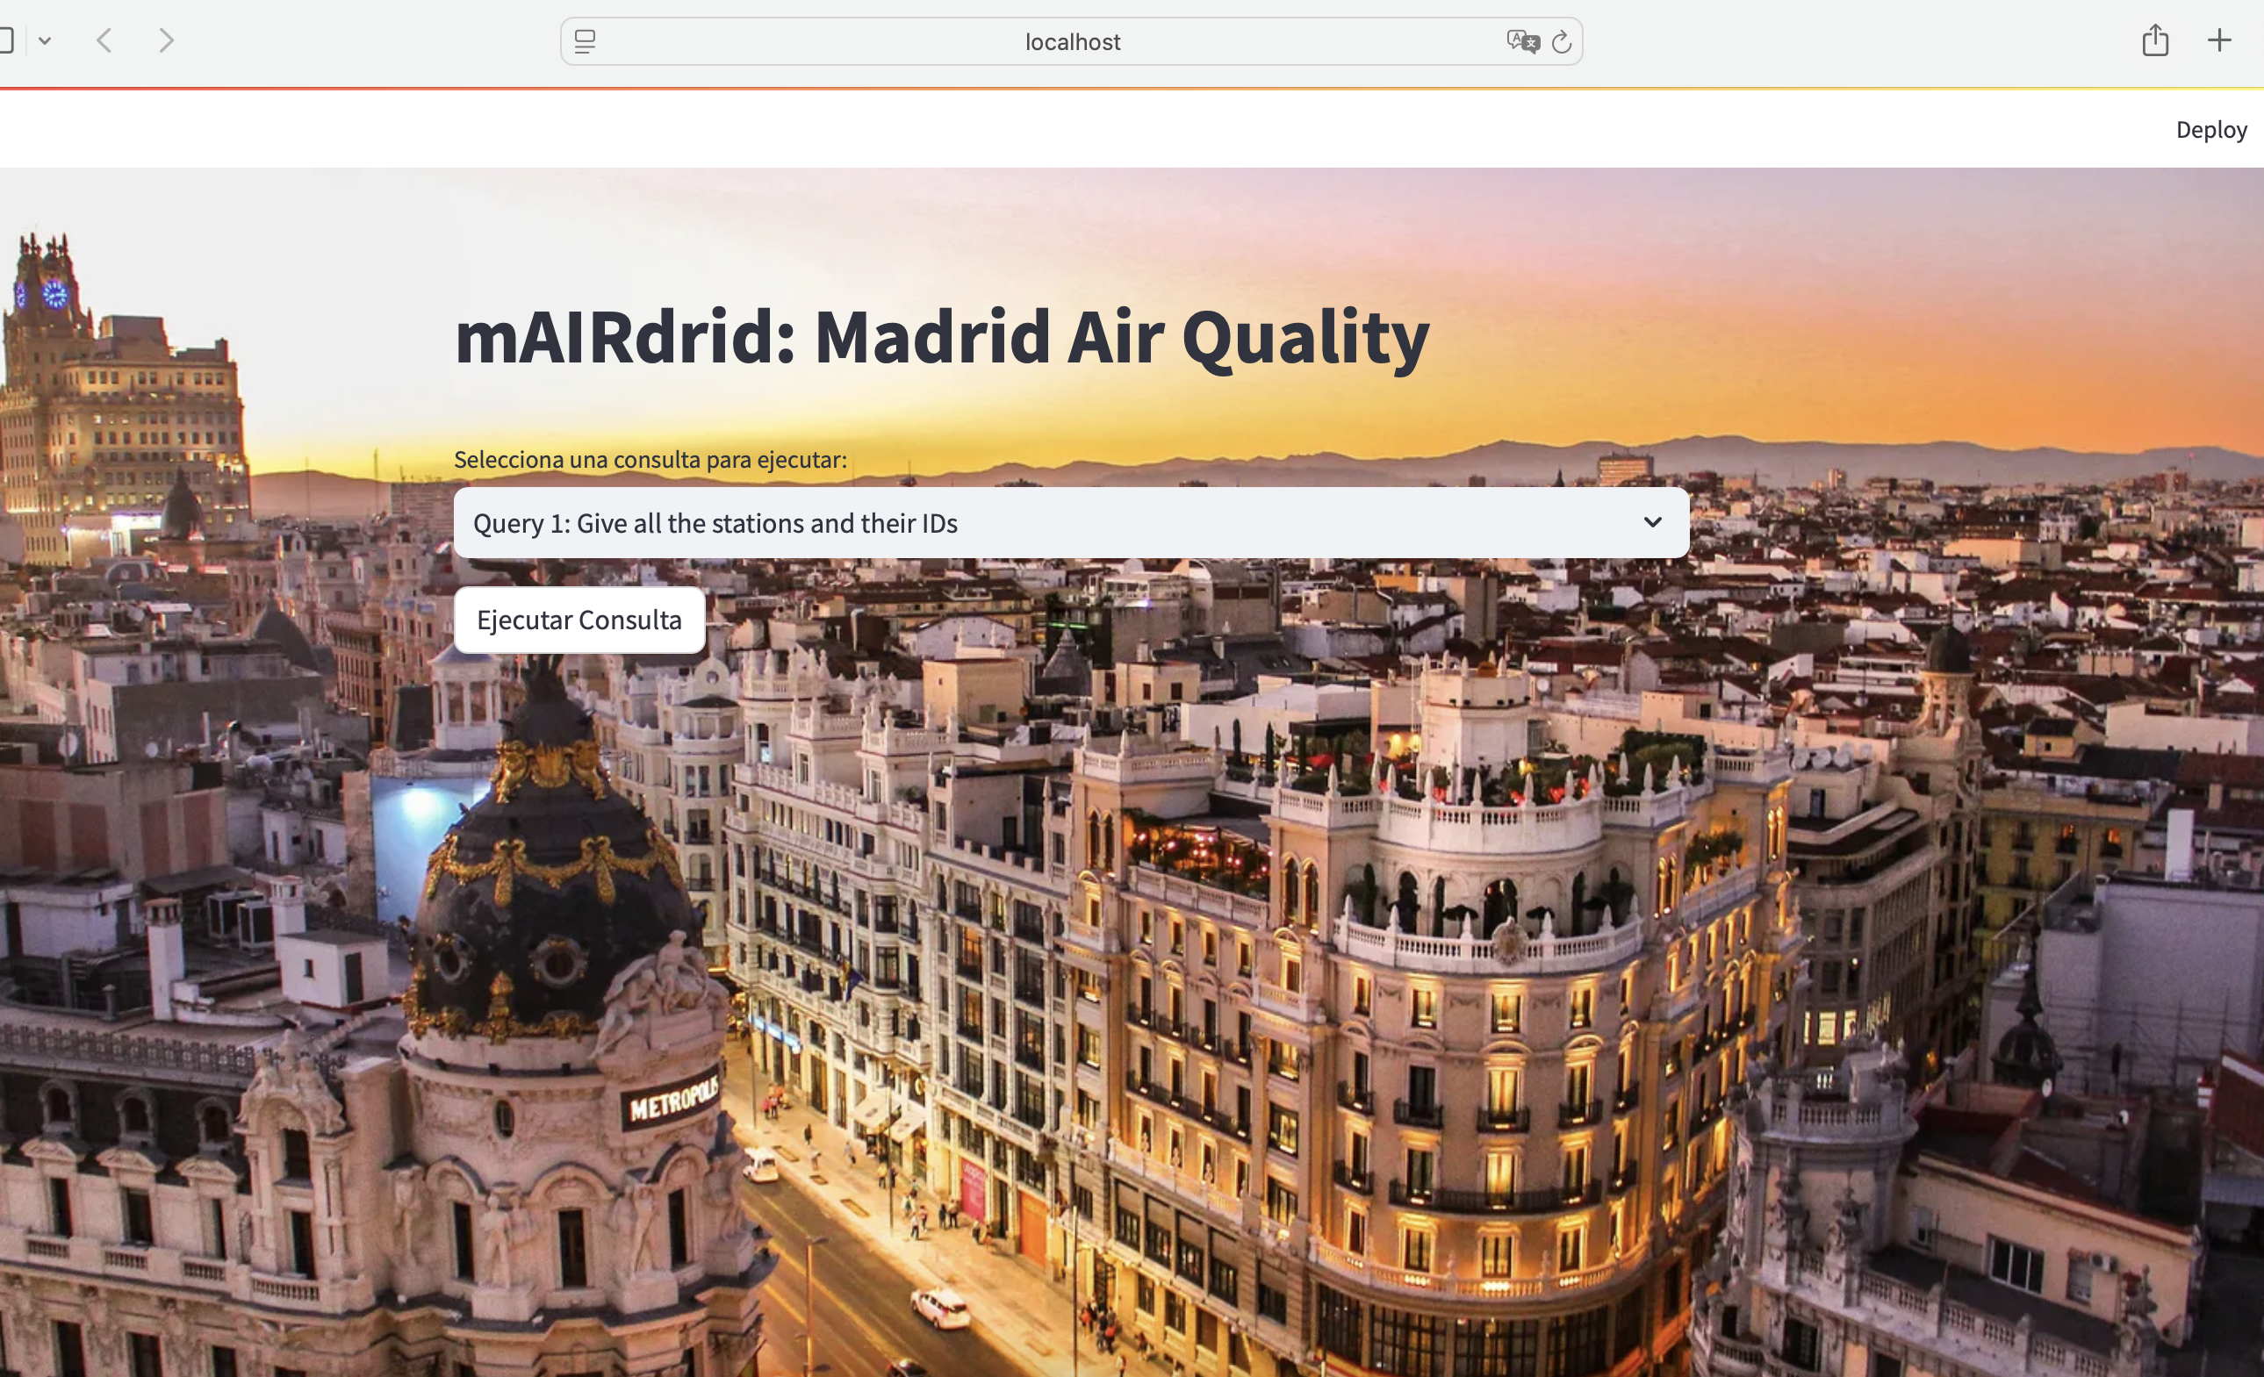
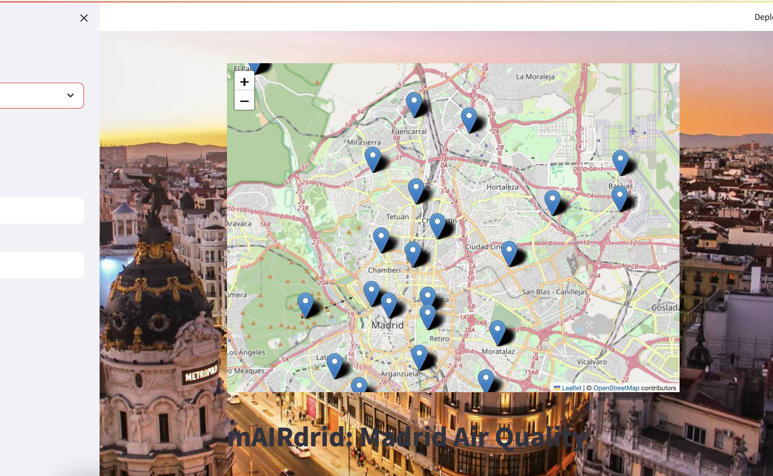
App
We connected our app code with the URL endpoint to remotely access to the data base, through SPARQLWrapper.
Using the python's library Streamlit we created an interactive web application which allows the user to search specific information about Madrid's air quality.

